Slide 1

WebToSpeech
Final Presentation
Names: John Hurley, Chandler Boone, Danny Lee, Brady Byrd

Slide 2
Contents
1.
7.
Introduction
Design Philosophies
2.
8.
Tools/Tech
Project Deployment
3.
9.
Page Structure
Remaining Issues
4.
10.
Timeline
Live Demo
5.
Project Scope
6.
Database

Slide 3
WebToSpeech Introduction
WebToSpeech is a web-based document reader that lets users upload their documents and have them read aloud via text-to-speech.
Users will also be able to create collections to organize their documents as they deem fit.
WebToSpeech provides users with a more accessible reading experience for those with reading disabilities, and is also a general platform for any user to have their documents read aloud for entertainment, education, or other purposes.

Slide 4
Tools/Tech
Category
Tools
Front End Languages
Web Framework
Libraries
Server
Database
Javascript, HTML, and CSS
React
WebSpeech API
Vercel
Supabase(Postgres SQL)

Slide 5
Other Notable Tech
Figma
Quickly turning design mockups into HTML and CSS
Lucide React
Importing SVG elements for easy UI creation options
Google OAuth
Google sign-in integration with Supabase
React Router
Handling navigation between pages within React

Slide 6
Page Structure Recap
Login Page
Dashboard Page
The first page shown to the user
Login button using Google OAuth
Central page upon signing in
Organize, access, and upload documents
Access profile page
Document Page
Profile Page
View contents of documents
Use text-to-speech to read text content
View user information
Edit collection titles, or delete collections.
Sign out

Slide 7
Timeline
Going Forward
Implementing scrapped features and broadening scope
Finalizing
Bug testing,
final features,
scope cuts…
Tech Integration
OAuth Sign-in,
database,
text-to-speech
Prototyping
First pages, layout design,
rough ideas
Planning
Proposal and requirements discussions

Slide 8
Project Scope
Text-To-Speech
Text-to-speech reading ✔
Speed and volume controls ✔
Multiple voice options ✘
Document Tools
Pagination ✔
Bookmarks ✘
Text annotation ✘
Document Handling
File uploading ✔
Collections ✔
More file support (.pdf, .epub) ✘
Other Missing Features
Document Filtering ✘
Public Collections ✘

Slide 9
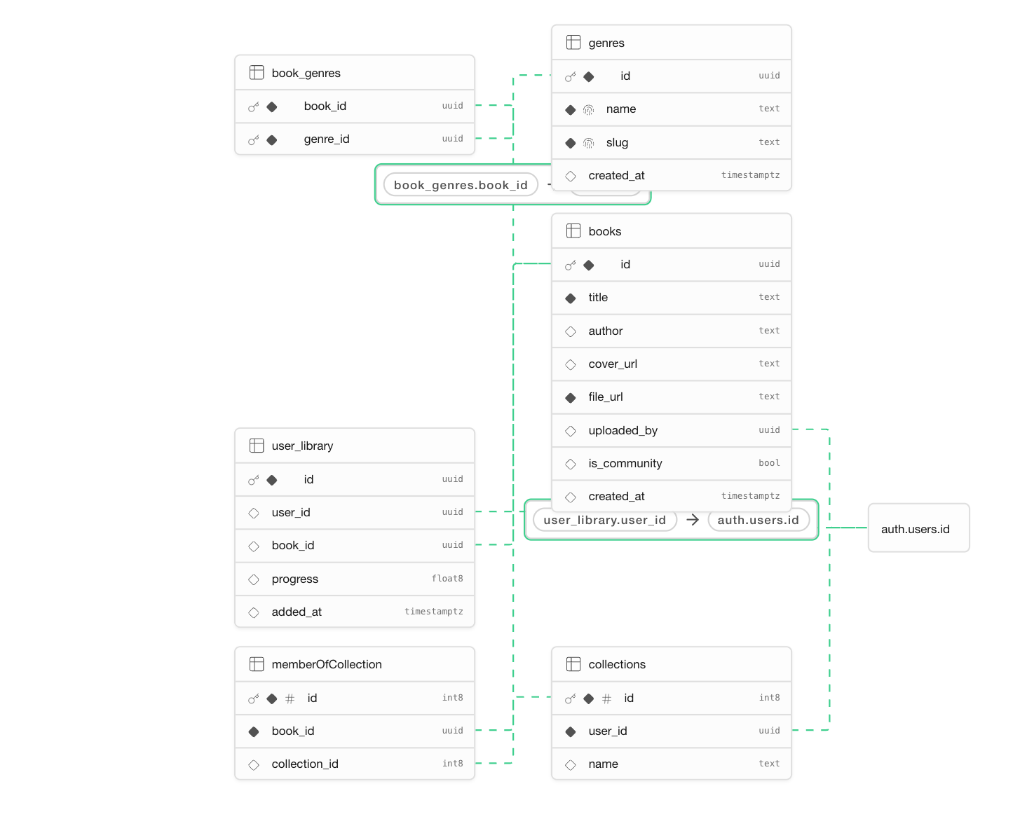
Database
File storage
Files are stored in buckets.
Access is limited by MIME types and RSL Policies.
User-books is private
Community-books is public

Slide 10
Design Philosophies
Mobile Implementation
Modularity
Build for mobile first then expand to fit web.
Breaking large classes/pages into smaller independent components.
Single Responsibility Principle
Every class should have only one well-defined responsibility.

Slide 11
Project Deployment
Download the “webtospeech” folder from our GitHub repository
Open in command line, run npm install
Create Supabase project
Obtain keys, set up project environment variables, load into supabaseClient.js
Configure Google OAuth and connect to Supabase
To host, import repository into Vercel and set Supabase variables on the Vercel project

Slide 12
Remaining Issues
No document filtering functionality on the Dashboard
Only the default text-to-speech voice is supported
Only support for uploading .txt files
Text-to-speech can’t be moved to start reading from a different spot
Google profile image url rate limits can cause it to not display

Slide 13
Live Demo
https://webtospeech.vercel.app/

